Slide 1
Social Harms Reporting in MTN-017

Slide 2
Social Harms
Social Harm - non-medical social consequence of study participation
Example: stigma/discrimination from members of community or family, difficulties in personal relationships with partners, family, or friends
Ppts asked about social harms at each f/u visit, and can report at any time during study
Visit checklist trigger
Care, counseling, follow-up provided per SSP manual, section 9.11 guidance
Document each on Social Impact Log CRF at time of report
Notes:
Despite efforts to protect participant’s confidentiality and privacy, participants may experience social harms as a result of participating in MTN-017. Social harms are defined as non-medical social consequences that are related to study participants and some examples include discrimination/stigma from community or family members or problems in personal relationships. Participants will be explicitly asked to report any social harms at each mid-period and End Period Visit. They should be encouraged to report social harms spontaneously at any study visit.
Strategies for preparing for and responding to social harms will be detailed in the SSP.
For MTN017, we will capturing social harms that directly relate to study participation on a Social Impact Log CRF.
Next we will go through a couple scenarios when a social harm would be reported and how to document the incident.

Slide 3
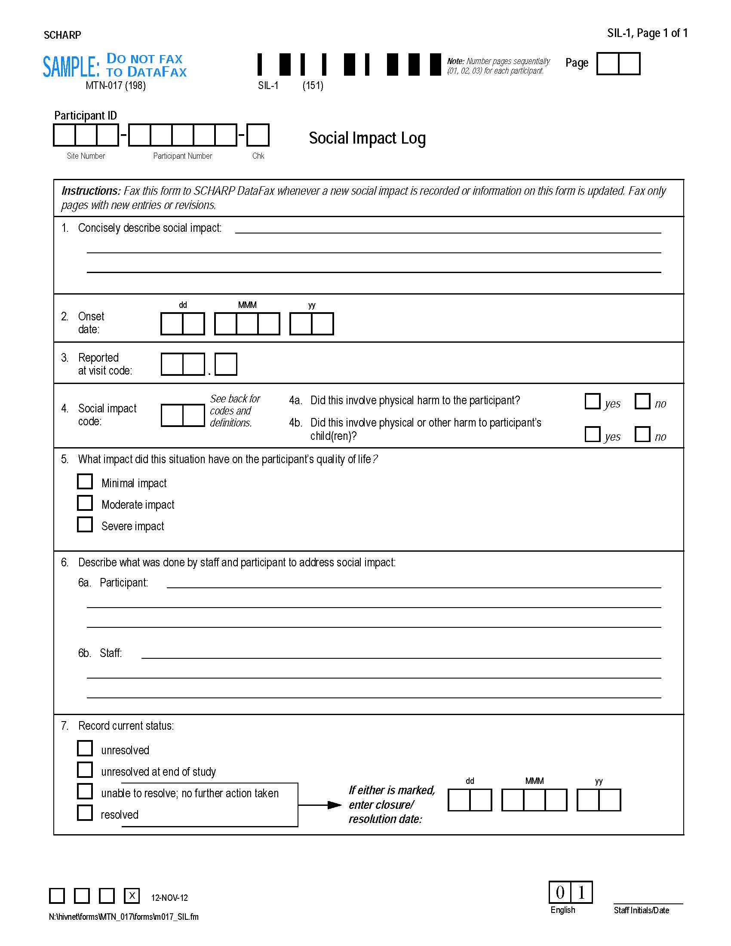
Social Impact Log CRF
Social Impact Codes
Reporting of Physical Harm
Notes:
2 items to point out on the SIL form: Social impact codes for Item 4 and reporting of physical harm.
Item 7 can be updated at future visits once the social harm status changes.

Slide 4
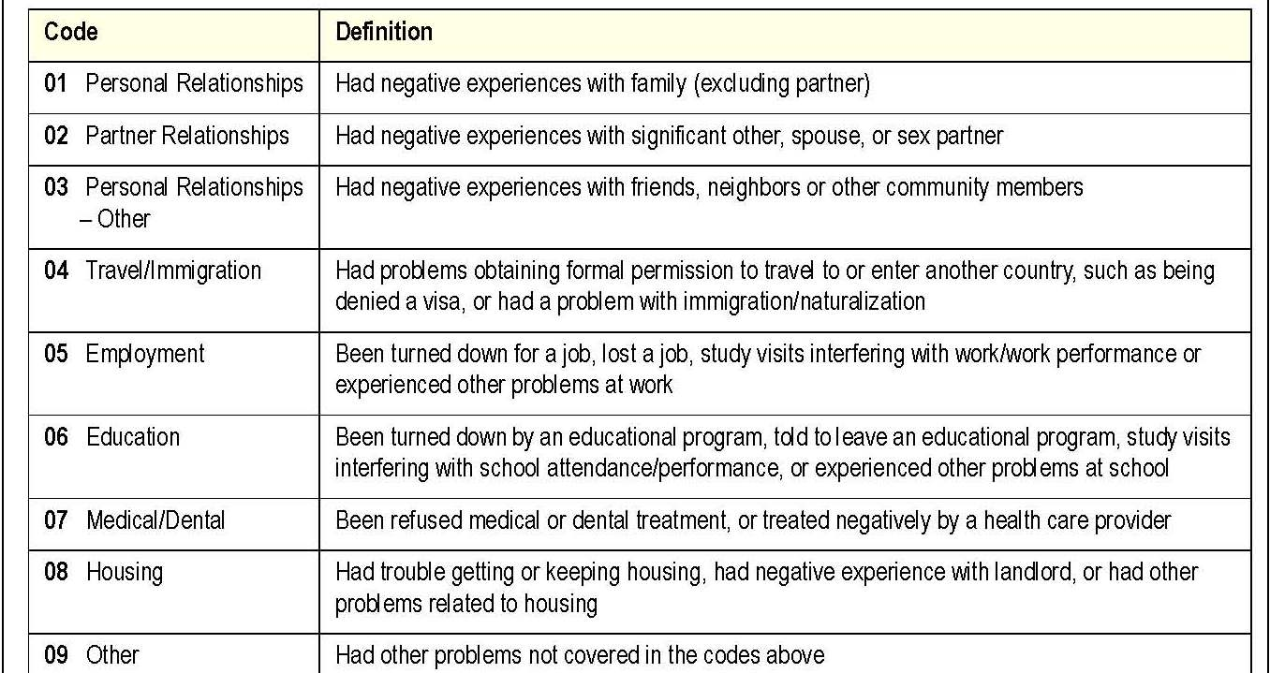
Social Impact Log CRF – item 4
If a social harm meets two or more codes, complete one SIL CRF for each code/each type of harm experienced
Social Impact Codes
Notes:
A list of social impact codes are included on the back instructions of the Social Impact Log CRF for your reference.

Slide 5
Social Impact Log CRF
Items 4a and 4b – mark if the social harm involved physical harm to the ppt or his/her children
Onset and resolution dates documented per ppt report
Item 7 resolve date is when ppt felt the incident had resolved
Notes:
If the social harm causes a medical condition (e.g. physical harm), the AE needs to be documented, reported, and followed as with any other AE.

Slide 6
Social Harms – Scenario #1
At Visit 6 on March 23, 2014, participant (ppt) reports that he had a physical fight with his partner on March 15. As a result, the ppt reported bruising and a concussion.
The partner found out about the ppt’s involvement in the study and was angry, interpreting the use of HIV prevention drugs as an accusation of cheating and a lack of trust.
How is this social harm documented?

Slide 7
Social Harms – Scenario #1
Item 4: Reporting of Physical Harm
0 2
If yes, report as an adverse experience.
Notes:
In this scenario, item 4 code ’02’ indicates that the participant had a negative experience with a significant other. Item 4a would be marked ‘yes’ and 4b would be marked ‘no’. This physical harm would also be reported as an AE on the AE-1 Log CRF.

Slide 8
Unresolved (Ongoing) Social Harms Report
SCHARP to provide a site-specific monthly social harms report to each site
Includes all ‘unresolved’ social harms that have been ongoing for 30 or more days
Can be used as a guide for resolving/following up on Social Harms
If social harm is continuing (per ppt), no action needed with regard to the CRF
If social harm has resolved, update SIL CRF item 7, initial, date and re-fax

Slide 9
What Are Your Questions?

